Slide 1
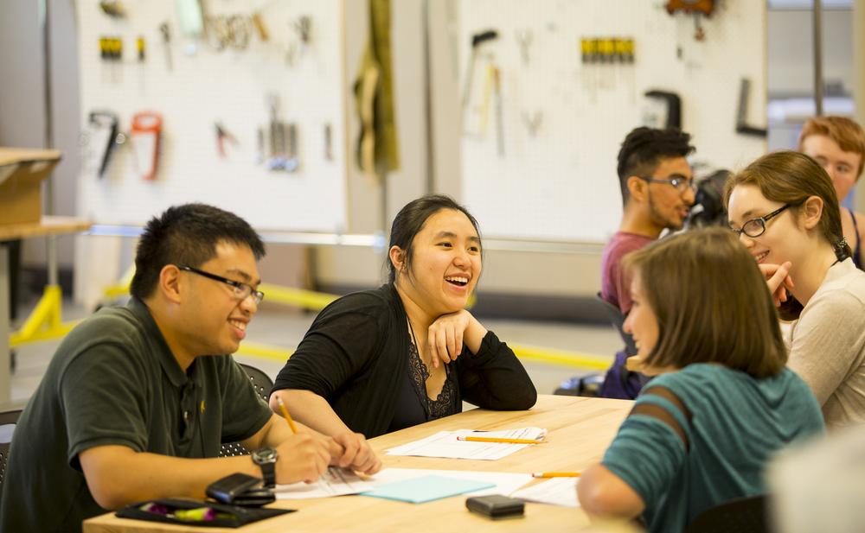
SECP 1513
Section 06
Design Thinking Project
Building Maintenance Management System
Technology and Information Systems
Leader
Designer
XU HAOJIE
LI HONGYU
Researcher
Editor
LI WENBO
Mohamed Brahim Khairy
Project Date
UTM
10/01/2026
Technology University

Slide 2
Table of Contents
01
Project Background & Objectives
05
Individual Reflections & Growth
Understanding UTM maintenance challenges
Team member insights and action plans
02
The 5 Phases of Design Thinking
06
Task Distribution
Empathy → Define → Ideate → Prototype → Test
Roles and responsibilities breakdown
03
Problem, Solution & Team Collaboration
07
Conclusion & Future Outlook
BMMS advantages and teamwork insights
Prototype to product roadmap
04
Design Thinking Assessment Points
08
Q&A Session
Evaluation and reflection metrics
Questions & Answers (5 Minutes)
Presentation Duration: 10 minutes | Q&A Duration: 5 minutes

Slide 3
PROJECT OVERVIEW
Background & Objectives
Background
Objectives
Many UTM students reside in hostels (Kolej), but facility maintenance faces significant challenges. The current reporting system relies on paper forms, leading to critical inefficiencies.
Develop the Building Maintenance Management System (BMMS) via design thinking to achieve:
Digitize Reporting
1
On-site Submission Required
Transform the reporting process for improved efficiency and accessibility.
No reporting during non-working hours (lunch breaks, weekends, holidays).
Enhance Transparency
Provide real-time progress tracking to eliminate information gaps.
2
No Progress Updates
Standardize Data
Repeated reports are common due to uncertainty about status.
Implement robust data management to reduce losses and enable analysis.
3
Forms Prone to Loss/Damage
Key Challenge
Paper forms are vulnerable to loss, damage, or disorganization.
UTM's hostel maintenance system serves over 12,000 students across multiple residential colleges, making efficiency crucial.

Slide 4
PHASE 1
Design Thinking Process
Empathy
Methodology
User Persona
Method 1
Method 2
Ali
Observation
Firsthand Experience
Maintenance Technician
Systematic observation of the current paper-based maintenance reporting process.
All team members are current UTM hostel residents, experiencing the pain points directly.
Pain Point
Spends 30% of working hours organizing forms and deciphering poor handwriting.
Need
Lacks a digital tool to prioritize urgent tasks and track report status efficiently.
Key Insight
Both user groups—students and maintenance staff—require an efficient, transparent communication and management tool to replace the current fragmented paper-based workflow.
Evidence
Observation Log
2
100%
Summarized pain points from 15+ reported issues.
User Groups Studied
Team Members are Residents
Staff Interview
Maintenance team: "We need better organization."

Slide 5
PHASE 2
Design Thinking Process
Define
Problem Statement
Residents of UTM hostels need a more efficient way to report facility damages, as the existing paper-based system causes lengthy repair delays and poor user experience.
Target Users: UTM Hostel Residents
Core Issue: Facility Damage Reporting
Students
Maintenance Team
Key Insight
Core Need
Core Need
The current system lacks transparency, creating a feedback gap that leaves users feeling ignored.
Real-time tracking of report status to eliminate anxiety and uncertainty.
Digital task lists with priority ranking and clear categorization.
Impact
Pending: Report received
Sort by urgency level
Students submit multiple reports for the same issue, increasing workload.
In Progress: Being handled
Filter by location
Completed: Issue resolved
Photo documentation

Slide 6
PHASE 3
Design Thinking Process
Ideate
Brainstorming Process
Our team conducted intensive brainstorming sessions, generating multiple solution concepts. Each idea was evaluated against user experience and technical feasibility criteria.
Rejected Ideas
Final Selection
Evaluation Criteria
WhatsApp Group
User Experience
Mobile App
Intuitive interface design
Reason: Disorganized chat flow; no tracking capability.
(BMMS)
Minimal learning curve
Messages get buried; difficult to search history.
Google Forms
Photo Uploads
Feasibility
Visually document damages for clarity.
Technical implementation
Reason: Submission-only; no status inquiry capability.
Maintenance & scalability
Status Tracking
One-way communication; no feedback mechanism.
Real-time progress visibility for users.
Notifications
Instant alerts for status updates.

Slide 7
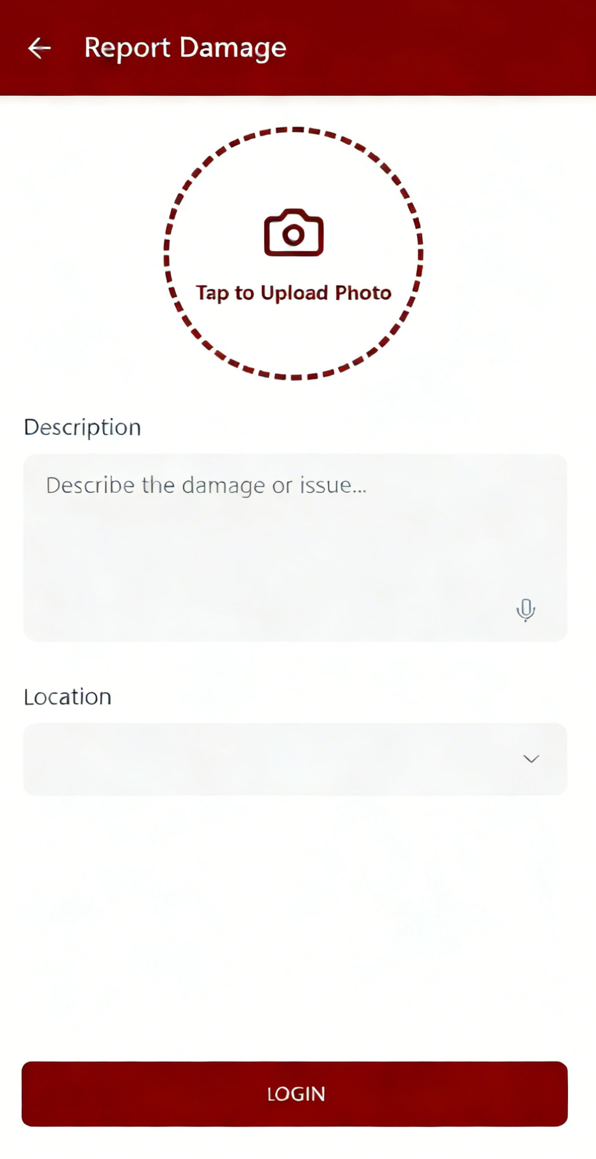
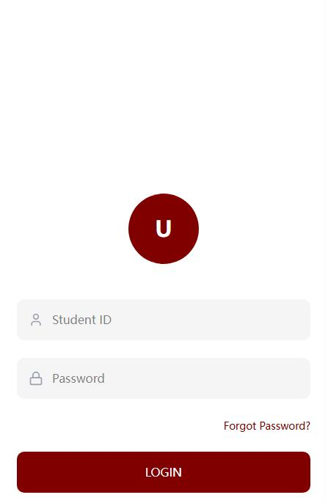
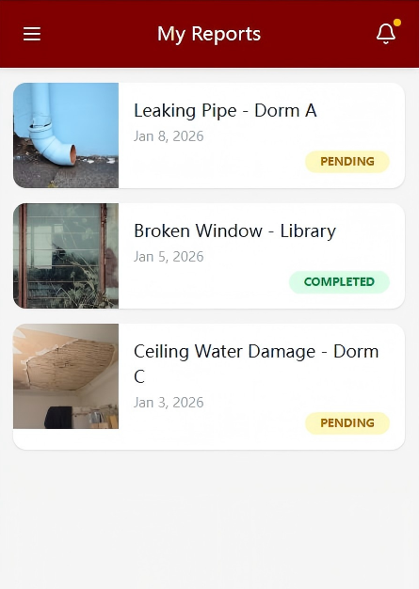
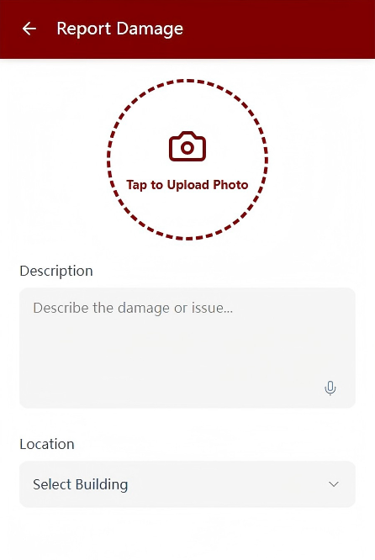
PHASE 4
Design Thinking Process
Prototype
Prototype Tools & Approach
App Interface Mockup
UI Design Software
Hand-drawn Sketches
For high-fidelity interactive mockups.
For rapid ideation and layout testing.
1
Login Page
2
Report Page
3
Status Page
Role-based access: Students & Maintenance Staff
Photo upload for visual evidence
Text description field
Displays all reports with progress
Secure authentication
Location selection (hostel/room)
Filter by status/location
Sample mobile app interface design

Slide 8
PHASE 5
Design Thinking Process
Test
Test Participants
Testing Insights
2
30min
Task Completion Rate
100%
UTM Hostel Students
Testing Duration
Active residents with recent maintenance requests
Each participant completed full workflow
Both users completed all tasks without assistance.
Average Task Time
1m 45s
Positive Comments
From login to report submission.
Clean Interface: "Very clean and professional looking. Easy to understand where to tap."
Subsequent Optimization
User-Friendly: "The reporting process is so smooth. I can submit a problem in less than 2 minutes."
Email Integration
Add email notifications for critical status updates.
Improvement Suggestions
Multi-language Support
Email Notifications: "Can you add email notifications when repairs are done? Sometimes I miss the app notification."
Add Malay and English for broader accessibility.

Slide 9
PROJECT SYNTHESIS
Problem, Solution & Team Collaboration
Core Problem
BMMS Solution Advantages
The paper-based maintenance reporting process at UTM hostels suffers from three critical inefficiencies:
Efficiency
Instant reporting accessible 24/7 from any location.
Low Efficiency
Requires physical submission during office hours only.
Transparency
Lack of Transparency
Real-time tracking eliminates information gaps and reduces anxiety.
No visibility into repair progress or completion status.
Standardization
High Risk of Loss
Paper forms vulnerable to damage, disorganization, or loss.
Digital data storage enables easy statistics and priority sorting.
Team Collaboration Insights
Challenge: Initial Disagreement
Success: Task Division
Web-based System vs. Mobile App
Strength-Based Assignment
Team members had differing opinions on the optimal platform for BMMS implementation.
Leveraged individual team member strengths for optimal project execution.
Resolution Process
Assignment Strategy
Conducted team vote for democratic decision-making
Design-focused member: Led prototype development
Referenced user persona needs for alignment
Research-oriented member: Conducted user interviews

Slide 10
PROJECT EVALUATION
Design Thinking Assessment Points
Assessment Node 1
Phase Transition
Define → Ideate
Verification Objective
Ensure the problem statement aligns with real-world observations to solve the "right problem."
Assessment Criteria
Does the problem statement accurately reflect user pain points?
Are user needs clearly defined and actionable?
Assessment Node 2
Key Findings
End of Project
Post-Test Evaluation
Strengths
The prototype addresses core pain points with a clean interface, high usability, and clear value for both students and staff.
Evaluation Objective
Evaluate if the prototype meets core user needs and identify specific optimization areas.
Key Metrics
User satisfaction ratings
Task completion success rate
Requires additional features (email notifications, multi-language) to adapt to a wider user base and ensure accessibility.

Slide 11
TEAM LEARNING
Individual Reflections & Growth
XU HAOJIE
LI HONGYU
Team Leader
Designer
Career Goal
Career Goal
Become a successful systems analyst
Become a project manager in a tech company
Project Impact
Project Impact
Learned that technical skills alone are insufficient; user empathy is critical for effective system development.
Gained insights into managing team conflicts and transitioning from ideas to products via structured processes.
Action Plan
Action Plan
Improve communication skills and learn more about User Experience (UX) design.
Participate in more hackathons to practice teamwork and leadership.
LI WENBO
Mohamed Brahim Khairy
Researcher
Editor
Career Goal
Career Goal
Become a software developer
Work in data science
Project Impact
Project Impact
Recognized that coding is only one part of development; the testing phase is crucial for bug detection and mprovement.
Learned to analyze complex problems by extracting patterns and insights from user behavior and observations.
Action Plan
Action Plan
Study additional programming languages (e.g., C++, Java) to build better prototypes.
Enhance analytical thinking and learn to present data clearly using tables and charts.

Slide 12
TEAM ROLES & RESPONSIBILITIES
Task Distribution
Assignment Strategy: Tasks were assigned based on individual strengths, skills, and career aspirations, ensuring optimal project execution and team learning.
Team Member | Primary Role | Key Responsibilities | Contributions
XU HAOJIE | Team Leader Project coordination &amp; decision-making | Coordinated team meetings and workflow Led problem statement formulation Facilitated conflict resolution | Established project timeline Managed team communication Compiled final presentation
LI HONGYU | UI/UX Designer Prototype design &amp; user interface | Created wireframes and mockups Designed user interface components Developed interactive prototype | Designed all app interfaces Created user flow diagrams Conducted usability testing
LI WENBO | Researcher User research &amp; data collection | Conducted user interviews Documented observation logs Analyzed pain points and needs | Created user personas Compiled research findings Supported prototype testing
Mohamed Brahim Khairy | Content Editor Documentation &amp; presentation | Documented team processes Created presentation materials Managed visual content and charts | Designed slide layouts Created data visualizations Edited and proofread content
Equal Participation: All team members contributed significantly to project success, with balanced workload distribution and collaborative decision-making throughout all phases.

Slide 13
PROJECT SUMMARY
Conclusion & Future Outlook
Conclusion
Future Outlook
Through the five phases of design thinking, we successfully developed the BMMS prototype, addressing core pain points of UTM's hostel maintenance reporting system.
1
Technical Implementation
Develop a fully functional app integrated with UTM's existing management systems for seamless data flow.
2
Feature Enhancement
Enhanced Collaboration
The project strengthened our team's collaboration, problem-solving, and user-centric thinking skills.
Add urgency labeling for reports and a maintenance staff rating system to improve service quality.
3
System Expansion
Extend BMMS to cover all UTM hostels and academic buildings, creating a unified facility management platform.
Design Thinking Value
We experienced firsthand how the structured process transforms complex problems into actionable solutions.
Expected Impact
BMMS can improve maintenance efficiency by 60% and reduce response times from days to hours.

Slide 14
Questions & Answers
5
Minutes
Feel free to ask questions about project design, technical implementation, future plans, or any other related topics!
App Features
Implementation
Future Plans
Functionality, user experience, technical specifications
Development timeline, integration challenges, resource requirements
Expansion strategy, feature roadmap, long-term vision
10/01/2026
SECP 1513 - Section 06 - GROUP 1

Slide 15
THANK YOU
2026/1/10
Repoter: Group 1
LI HONGYU XU HAOJIE MOHAMED BRAHIM KHAIRY LI WENBO

